Slide 1
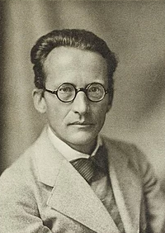

Schrödinger Fellowship: Non-invasive ex-vivo/in-vivo pre-clinical tissue analysis platform
Nobel Prize-winning Austrian-Irish physicist
Quantum theory
1887 –1961
*antonia.lichtenegger@meduniwien.ac.at

Slide 2
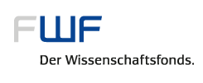

Erwin Schrödinger Fellowships
Fellowship of the Austrian Science Fund
(Fonds zur Förderung der wissenschaftlichen Forschung, FWF)
Target group: Young qualified scientists of any discipline
Promotion of scientific work at leading foreign research institutions, gaining experience abroad during the postdoc-phase
Access to new scientific areas, methods, procedures and techniques
Further development of science in Austria (returning phase)

Slide 3
Erwin Schrödinger Fellowships
Requirements
Completed doctoral studies
International scientific publications
Invitation from the foreign research institution
Confirmation of the Austrian research institution
Place of residence in Austria for at least 3 years
Fellowship: abroad: 10 to 24 months; return phase: max. 12 months
Benefits:
Fellowship abroad (tax free): 47,400 € per year
Return phase: personnel costs of 75,890 € per year and project specific costs up to 12,000 € per year
Additionally: Travel and conference costs

Slide 4
Erwin Schrödinger Fellowships
Application Procedure
Accepted continuously, no application deadlines
Online system for submission
Projects has to be in the field of basic research, clearly defined, convincingly described in terms of objectives and methods, and limited in time
Application
Academic abstract in English (3,000 characters)
Project description (50,000 characters - 20 pages)
Annexes (CV, citations, recommendation, invitation and collaboration letters)

Slide 5

Erwin Schrödinger Fellowships
Project description
Clearly defined aims and hypotheses of the project
Description of the project’s level of originality or innovation
State of the art
Methods
Cooperation arrangements
Work plan and timeline
Ethical, safety, regulatory, sex-specific and gender-related aspects

Slide 6
Non-invasive ex-vivo/in-vivo pre-clinical tissue analysis platform
Cancer is going to remain a major cause of mortality and morbidity
Hypotheses of the project
Multi-modal, optical coherence microscopy (OCM) is a multi-method approach for in-vivo and ex-vivo investigations in pre-clinical cancer research.
Multi-modal OCM can non-destructively generate images similar to histology based on tissue-specific contrast.
Multi-modal OCM is a sensitive method to differentiate pathological and healthy areas in cancer tissue.
Artificial intelligence (AI) can automatically identify regions of interest from OCM data to facilitate the imaging procedure for the operator.

Slide 7
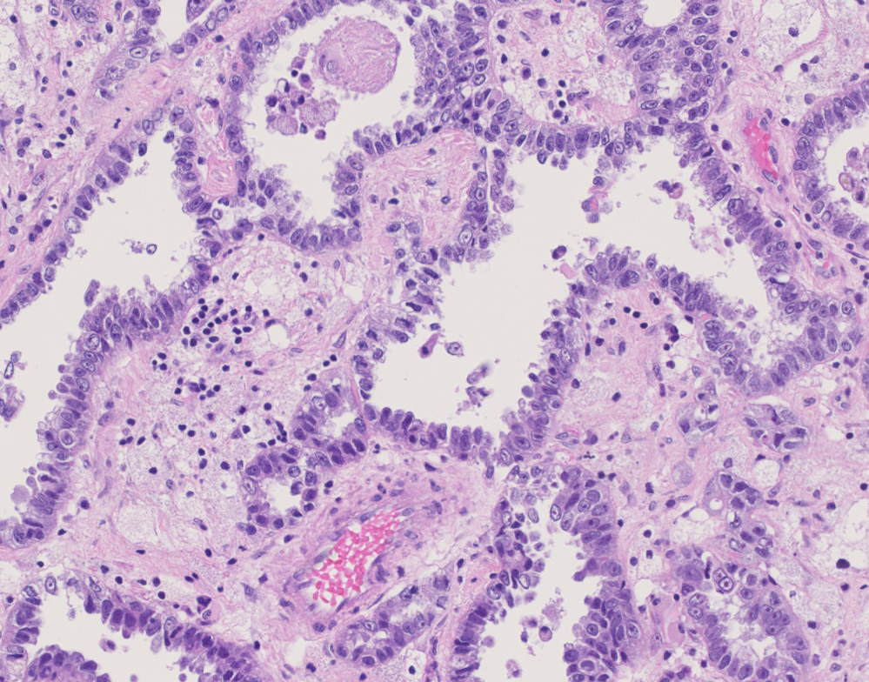




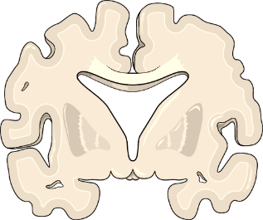
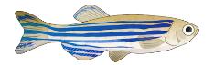
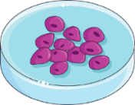
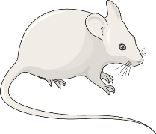
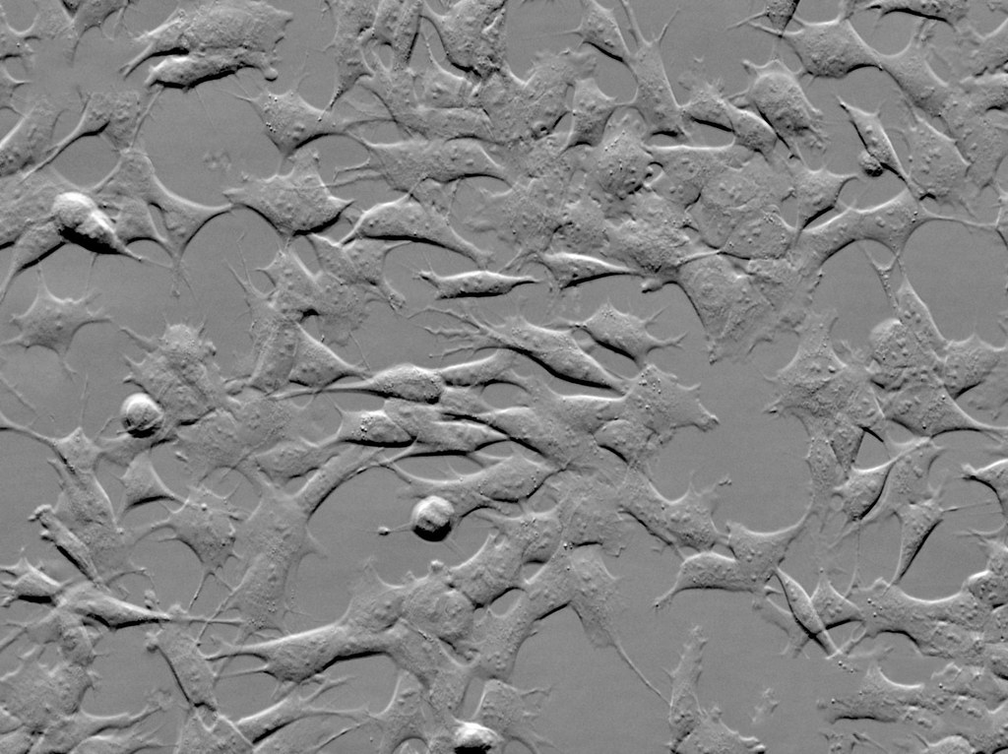
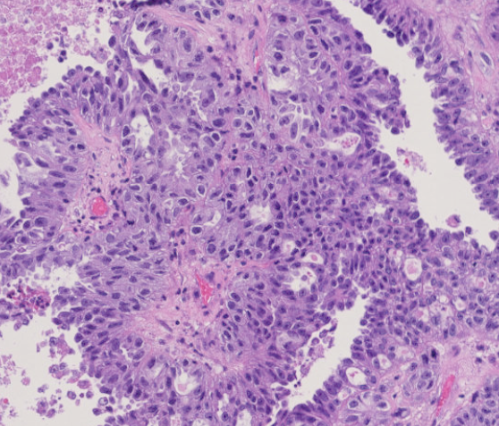
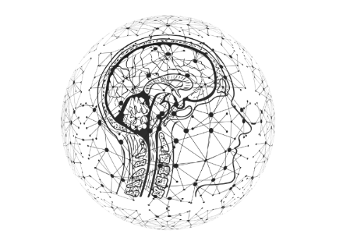

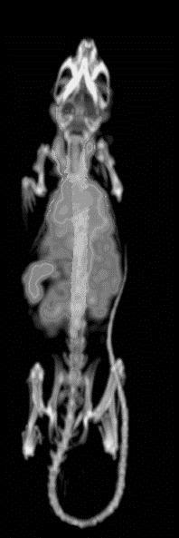
Methods
1. Multimodal OCM setup
2. Multi-contrast data processing
3. Data visualization
Ex-vivo tissue samples
In-vivo animal imaging
OCM
Objective
Attenuation
Dynamic OCT
Phase contrast
PS-contrast
Histology-like image including additional information
In-vitro cell imaging
6. Establishment of new imaging protocols
5. Data validation
4. Data evaluation
Comparison to MR/CT imaging
Statistical evaluations
Artificial intelligence selects automatic regions of interests perform long term measurements
One-to-one correlation to histology
Scientific articles

Slide 8
Work plan and timeline
University of Tsukuba
Medical University of Vienna
Jul – Aug.
2020
Sep. – Oct.
2020
Nov. – Dec.
2020
Jan. – Feb.
2020/21
Mar. – Apr.
2021
May. – Jun.
2021
Jul. – Aug.
2021
Sep. – Oct.
2021
Nov. – Dec.
2021
Jan. – Feb.
2021/22
WP-1: OCM/OCT system development
WP-7: OCM system development
WP-2: Software development
WP-8: Software development
WP-3: Imaging
WP-9: Imaging
WP-4: Data evaluation
WP-5: Data validation
WP-6: Scanning protocol development
WP-10: Scanning protocols

Slide 9

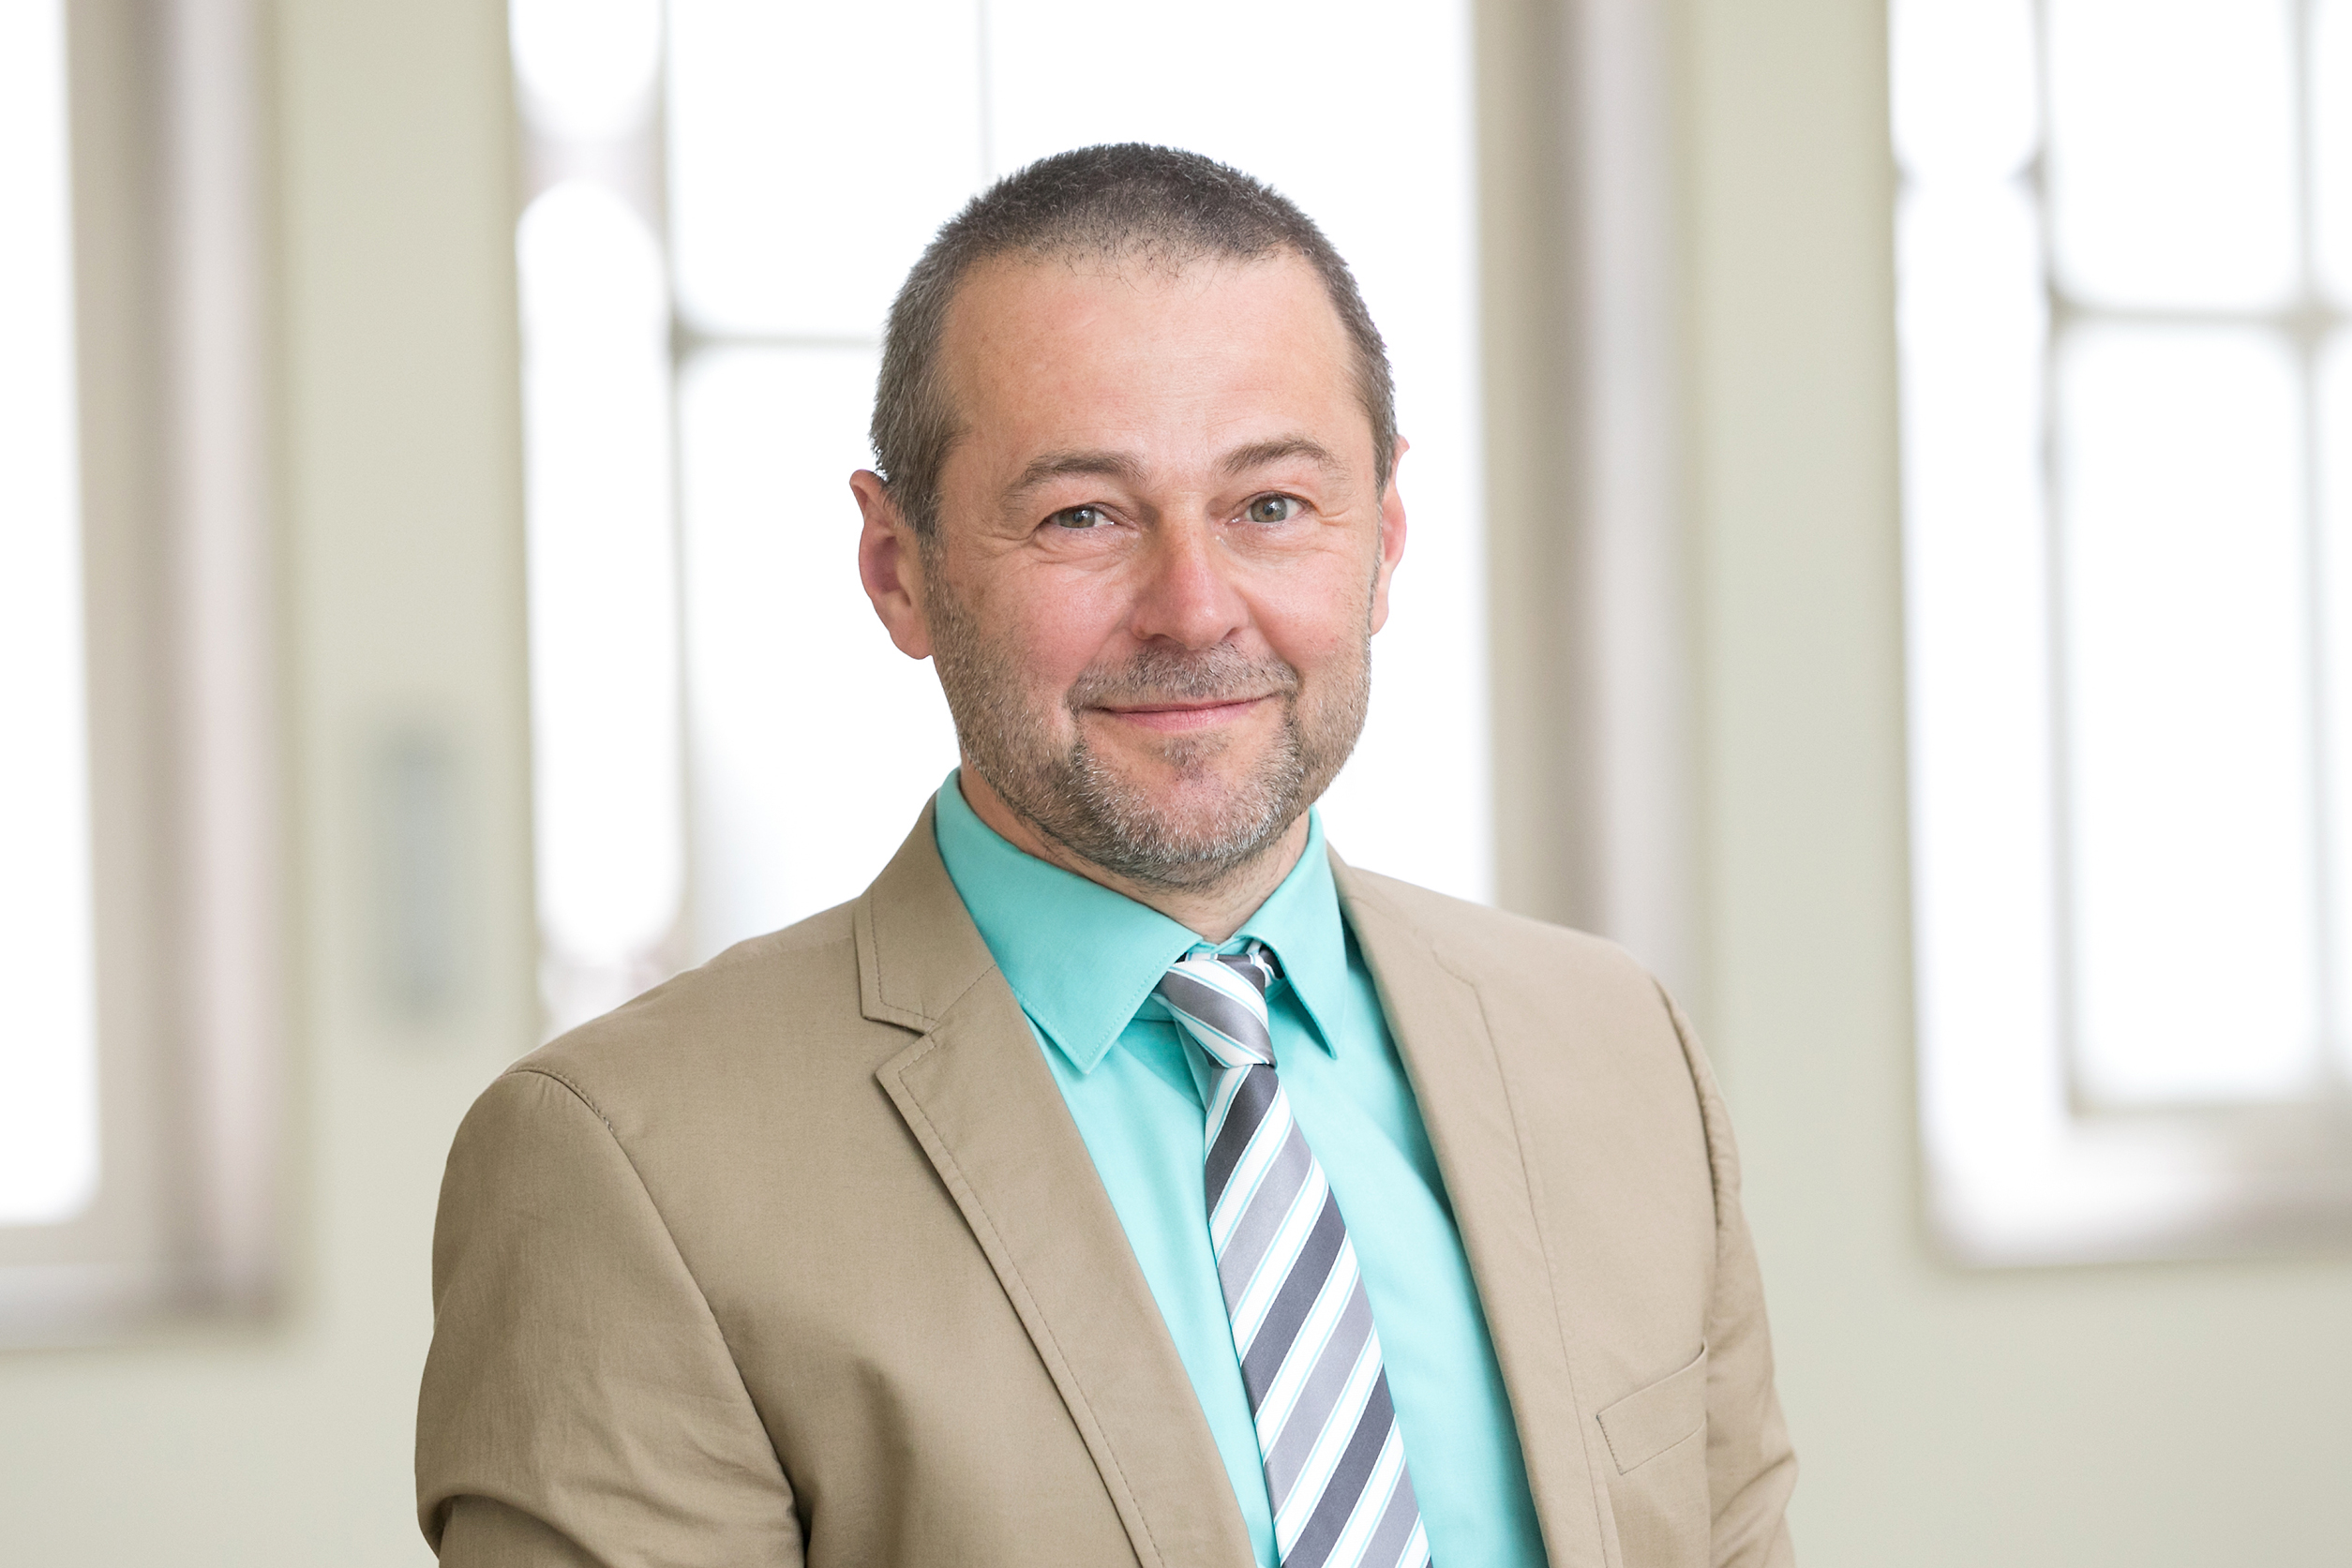
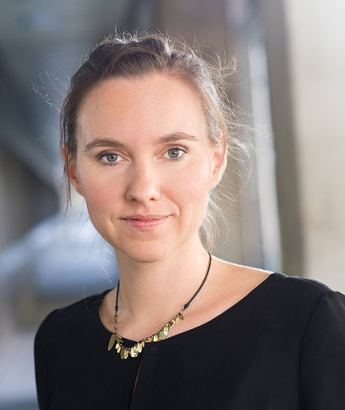

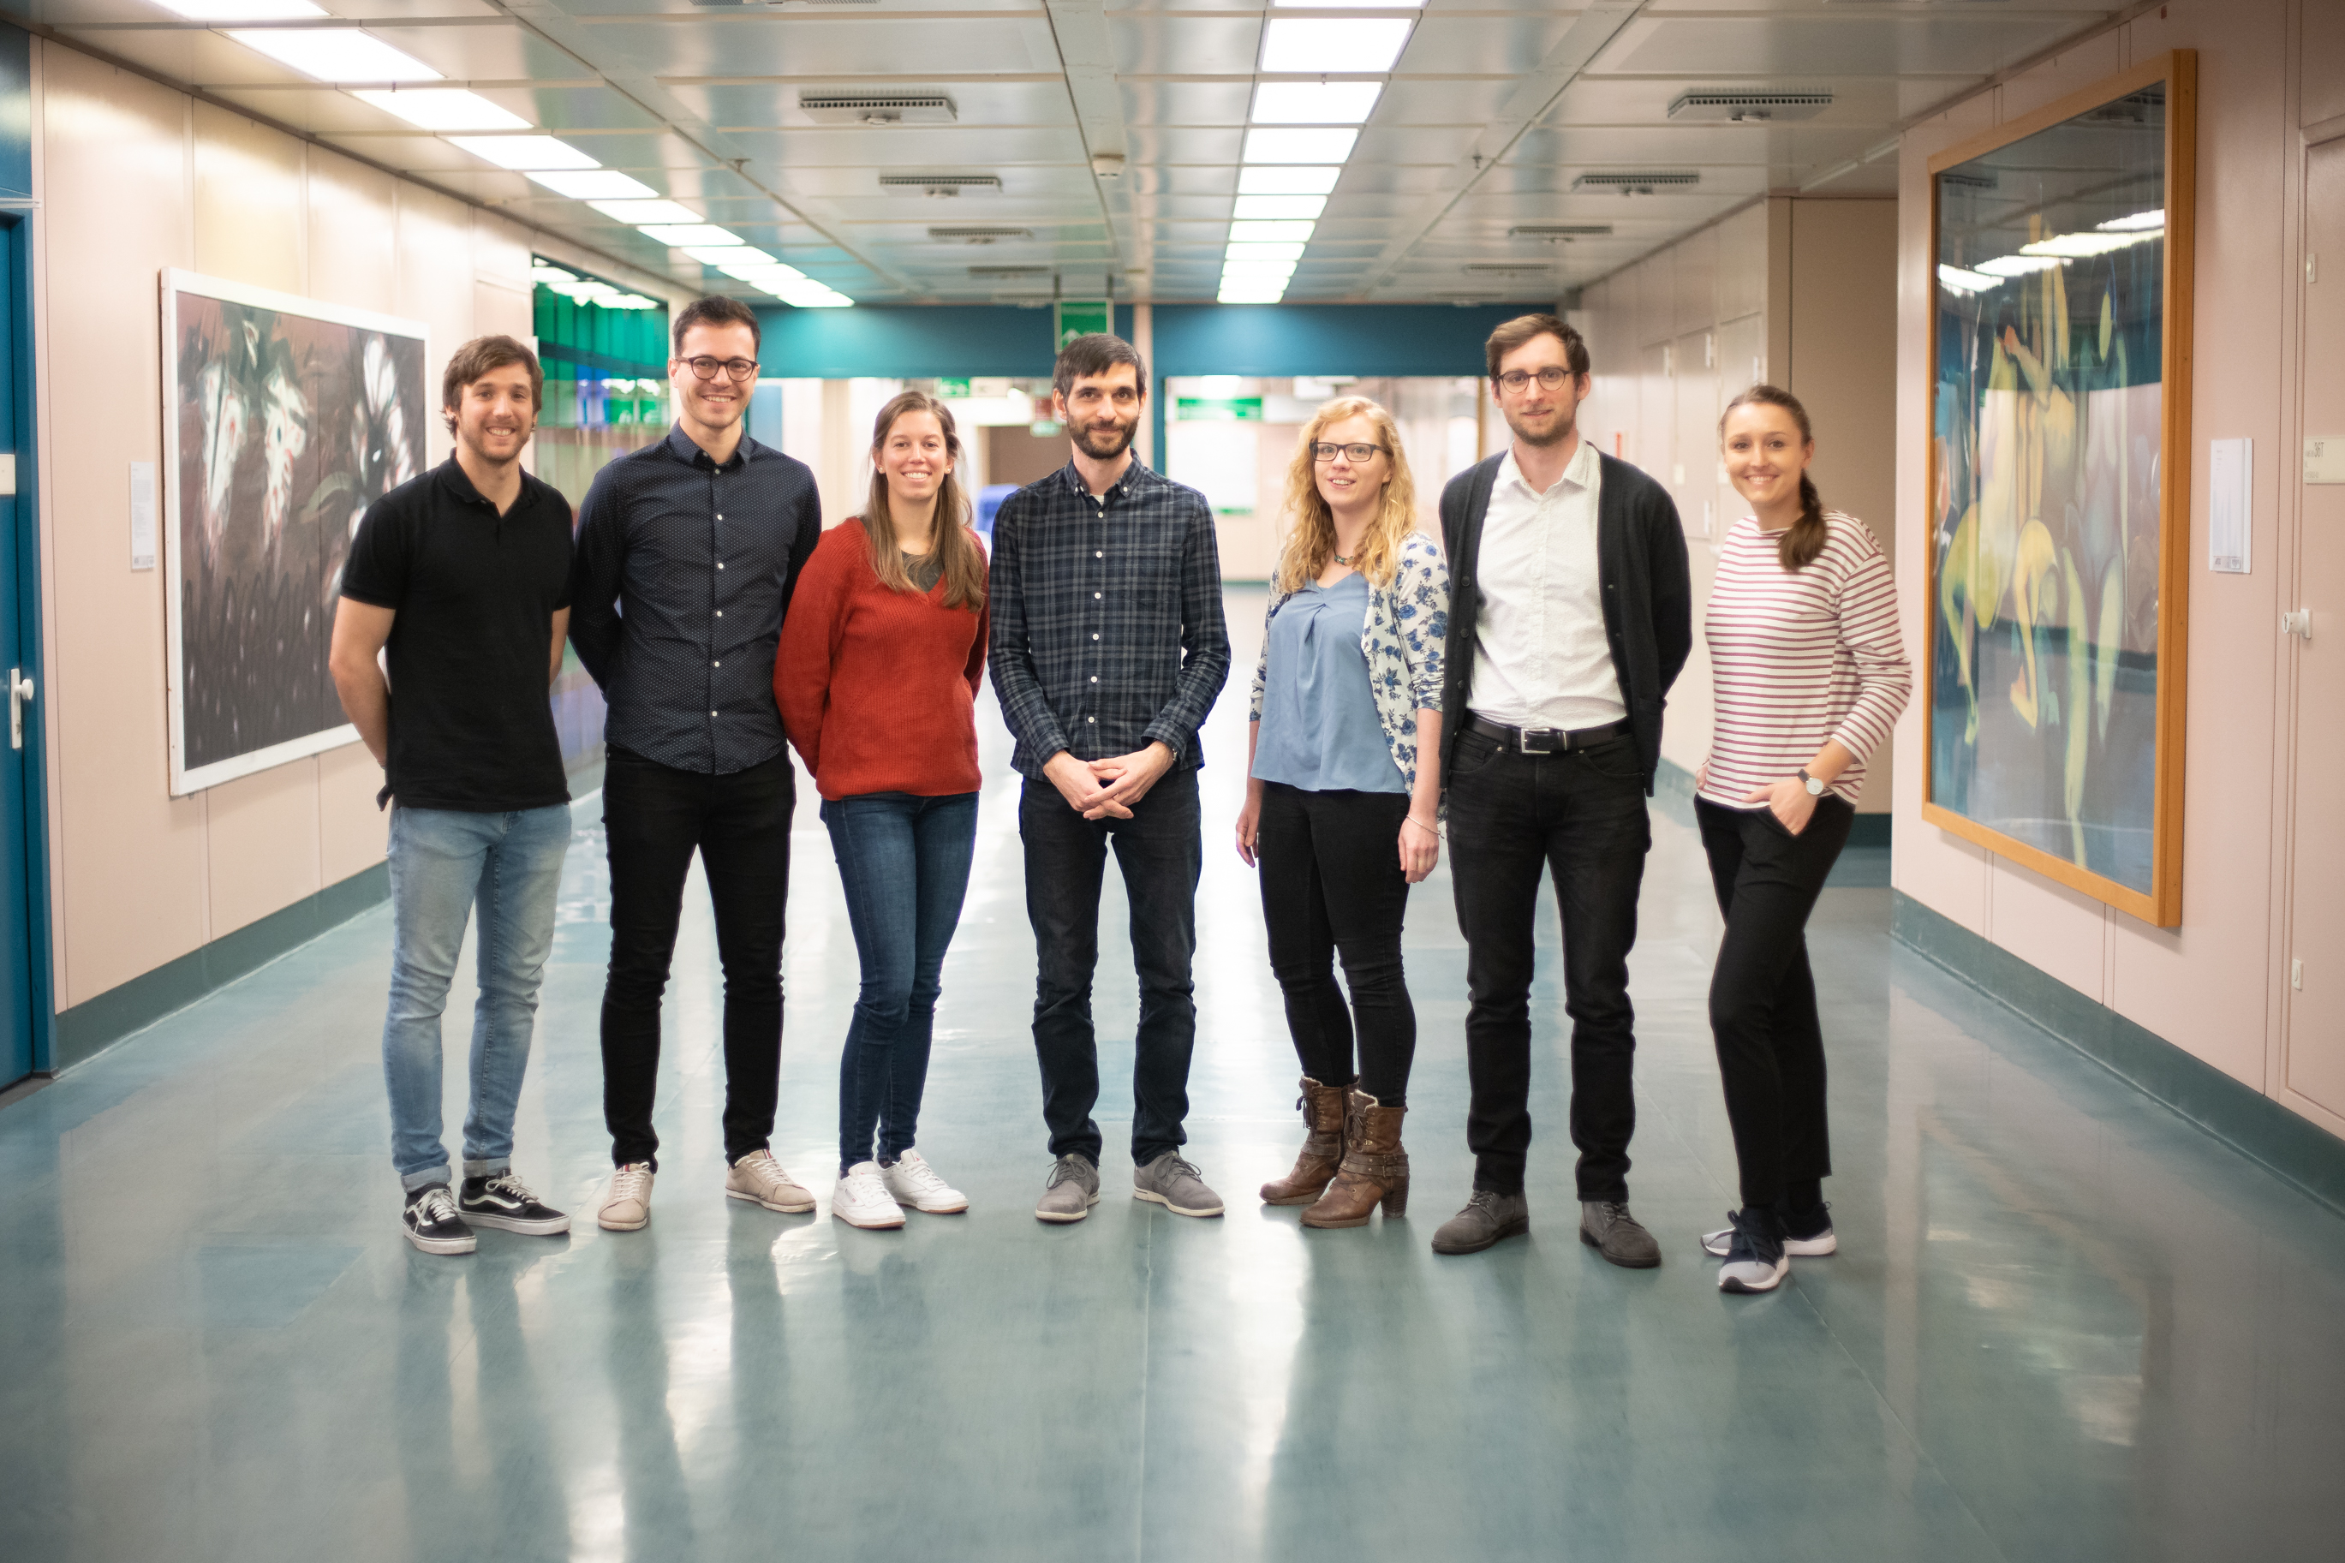
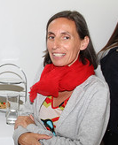
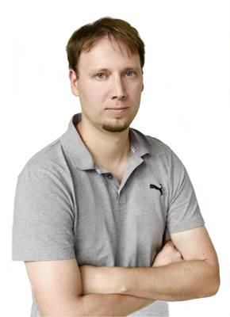
Collaboration partners in Vienna
Wolfgang Weninger
Adelheid Wöhrer
Baumann lab
Marion Gröger
Martin Distel

Slide 10


Expected results
Improve and advance ex-vivo and in-vivo pre-clinical tissue analysis
Novel, fast, relatively inexpensive and highly advanced method for real-time, non-destructive tissue imaging
Facilitate investigations in three major pre-clinical scientific fields for cancer research, ex-vivo tissue analysis, in-vivo/in-vitro cell culture and animal model research.
Detector 1
Detector 2
PBS
PBS
Computer
BS
Swept Laser
Sample arm
BS
Scanning
lens
Scanning optics
Translational stage
y
x
z
BS…Beam splitter
PBS…Polarization BS

Slide 11

Link: https://www.fwf.ac.at/en/research-funding/application/schroedinger-programme/
ERC Starting Grant 640396 OPTIMALZ
Baumann Lab Bernhard Baumann Conrad Merkle Danielle J. Harper Marco Augustin Pablo Eugui Johanna Gesperger
Collaborators in Austria
Adelheid Wöhrer Marion Gröger Wolfgang Weninger
Martin Distel
Collaborators in Japan
Yoshiaki Yasuno
Shinichi Fukuda
Hideaki Kano
Masahiro Miura
Satoshi Matsusaka

